Slide 1






Axon Project on CRM Analytics

Slide 2


Group details
Group Number 4
Chaithra S V
Janhavi Dusad
Akshay Sawant
Susmita Das
Srishti
Soundarya G S

Slide 3



Summary
We have built a dashboard in Excel, Power BI, and Tableau to track the full journey from leads to converted customers.
It shows all key KPIs in one place, making it easy to see where leads come from, how many convert, and the revenue they bring and much more which are described in KPIs
Objectives
Combine lead and opportunity data into one clear view
Find the best lead sources and industries
Help teams make faster, data-backed decisions
Give access across different tools for wider use
Impact
Better targeting by knowing top-performing sources
Faster action on bottlenecks in the funnel
Easy access for all teams, in their preferred tool
More accurate revenue forecasting

Slide 4
KPIs
for Opportunity Dashboard
for Lead Dashboard
Expected Amount
Active Opportunities-Total count of open opportunities.
Conversion Rate (%) = (Win Opportunities/Total Created Opportunities​)×100
Win Rate (%) =(Won Opportunities/(Win +Lost)Total Opportunities​)×100
Loss Rate(%) = (Closed Lost Opportunities/Total Opportunities​)×100
Trend Analysis
Expected Amount by Opportunity Type
Opportunities by Industry
Total Lead
Expected Amount from Converted Leads
Conversion Rate(%)=(Leads Converted to Customers/Total Lead​)×100
Converted Accounts
Converted Opportunities
Lead By Source
Lead By industry
Lead by Stage

Slide 5
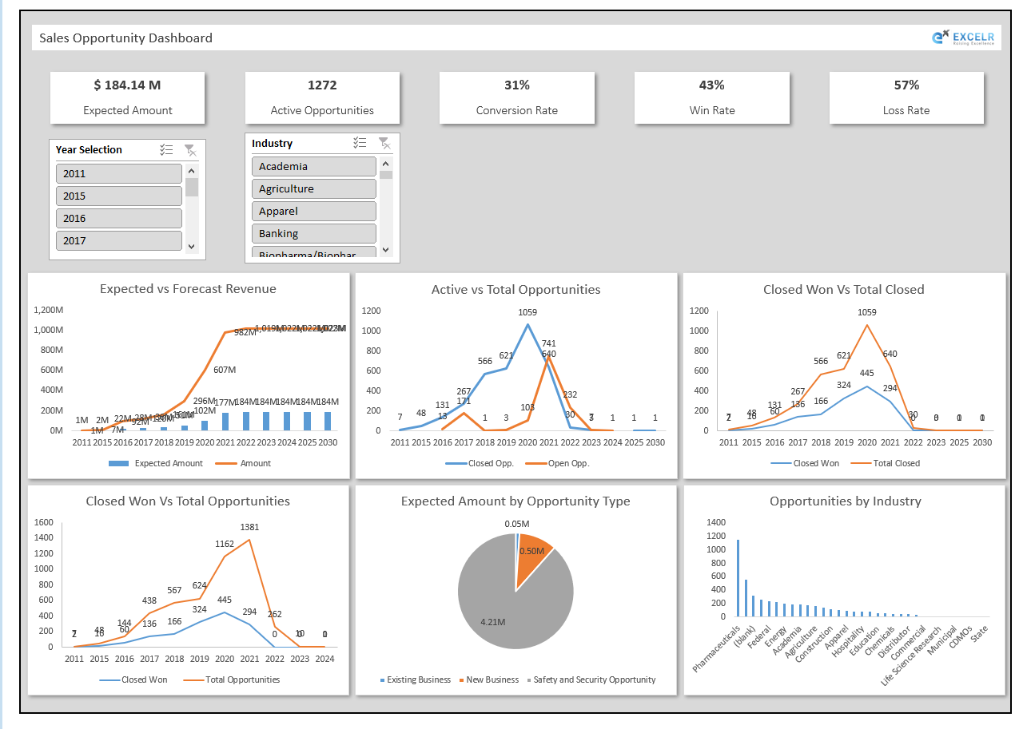
Excel Dashboard (1/2)

Slide 6
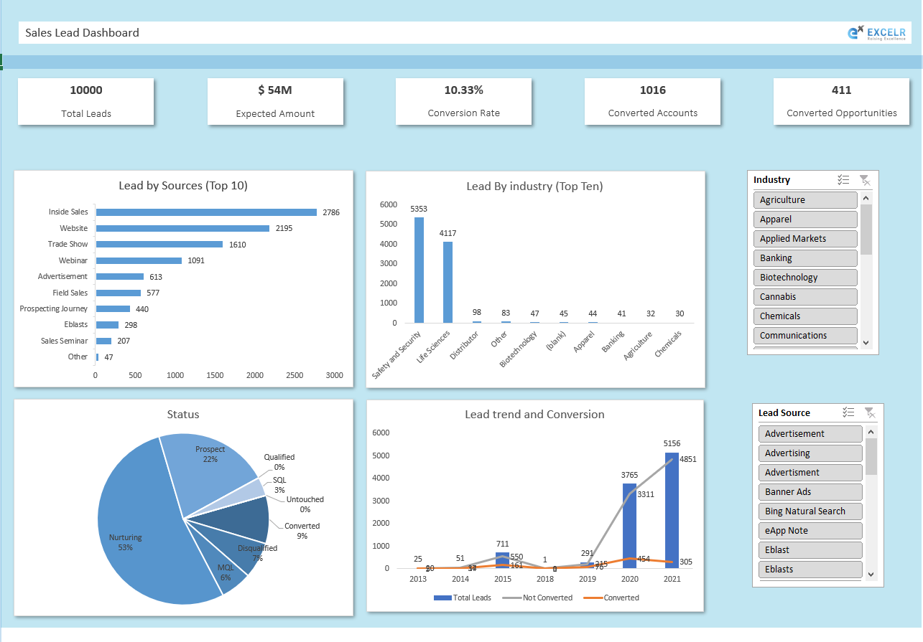
Excel Dashboard (2/2)

Slide 7
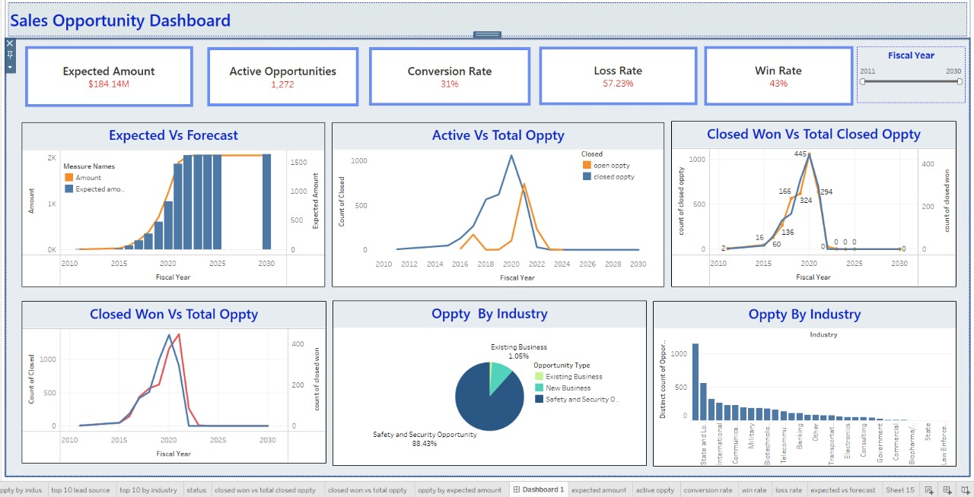
Tableau Dashboard (1/2)

Slide 8
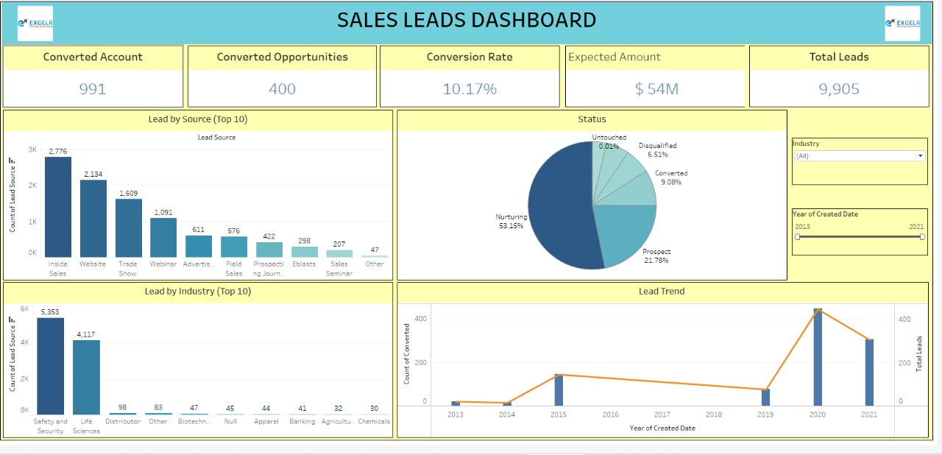
Tableau Dashboard (2/2)

Slide 9
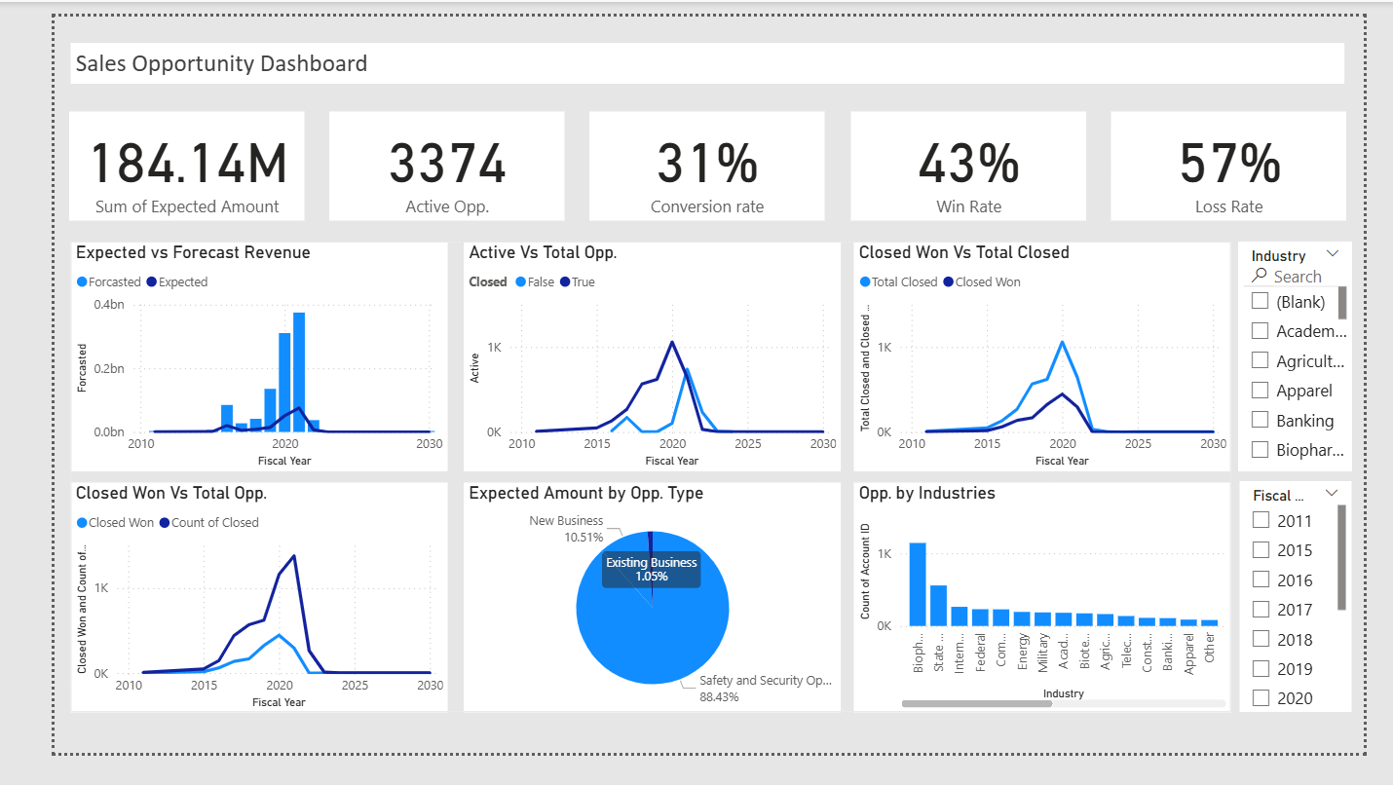
Power BI Dashboard (1/2)

Slide 10
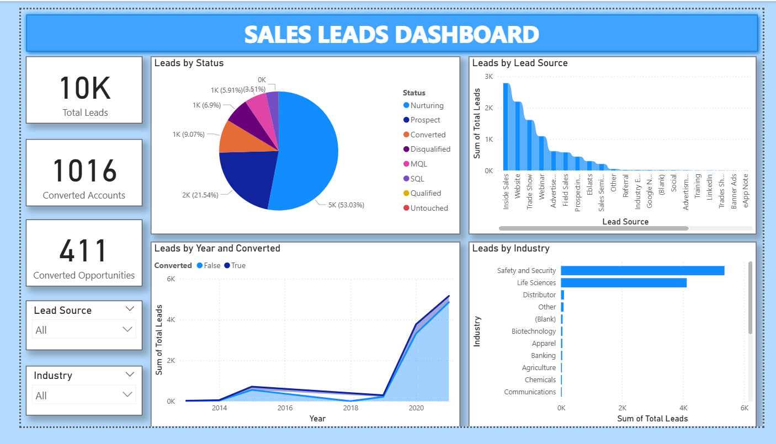
Power BI Dashboard (2/2)

Slide 11
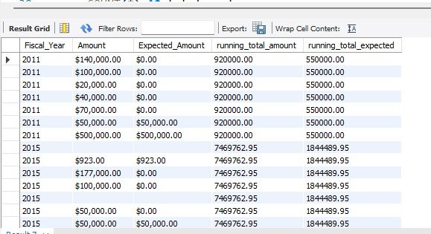
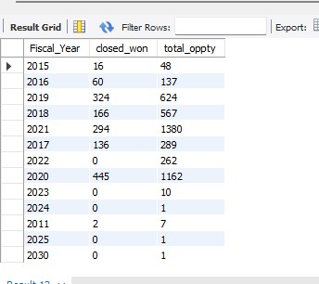
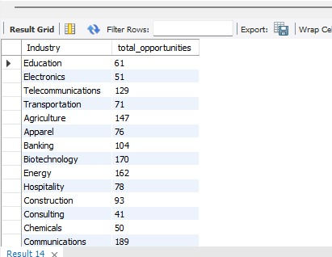
SQL Query(1/2)

Slide 12
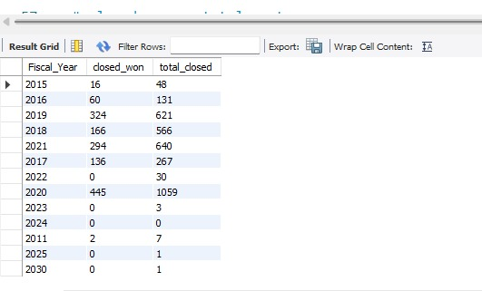
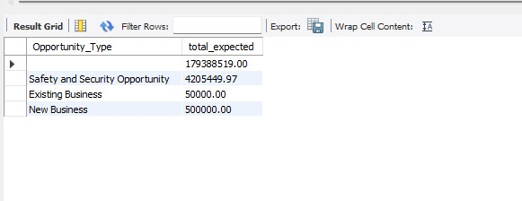
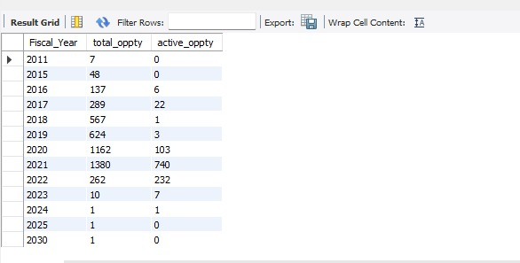
SQL Query(2/2)

Slide 13
Takeaways - KPIs
for Opportunity Dashboard
for Lead Dashboard
Expected Amount - $184.14M
Active Opportunities -1272
Conversion Rate (%) – 31%
Win Rate (%) – 43%
Loss Rate(%) -57%
Total Lead – 10,000
Expected Amount from Converted Leads - $54M
Conversion Rate – 10.33%
Converted Accounts – 1,016
Converted Opportunities - 411

Slide 14
Takeaways- Business Insights
for Opportunity Dashboard
Expected vs Forecast Revenue – From 2020 onward, the revenue forecast shows a sharp increase and then stabilizes, indicating a strong future outlook.
Active vs Total Opportunities-There was a spike in total activity around 2020. Post-2022, both open and closed opportunities decline sharply.
Closed Won vs Total Closed -Not all closed deals were successful. The peak occurred in 2020.
Closed Won vs Total Opportunities - Even when opportunities increased (2019-2021), not all were converted into wins
Expected Amount by Opportunity Type -Majority of expected revenue comes from existing business, suggesting strong client retention but less new acquisition.
Opportunities by Industry- Pharmaceuticals, Industrial, and Apparel industries dominate.
Tail industries like CDMOs, CROs, and Space have lower counts.

Slide 15
Takeaways- Business Insights
for Lead Dashboard
Lead by Sources (Top 10) – Inside Sales and Website are the most productive sources, Offline sources like Trade Shows and Webinars also contribute significantly
Lead by Industry (Top 10)- Safety & Security and Life Science industries dominate lead generation, Other industries contribute minimally.
Lead Trend and Conversion – Major growth in leads and conversions happened in 2020 and 2021, Most leads were converted during those years (high efficiency).
Status - 53% of leads are still being nurtured (in pipeline), Only 9% have been converted, showing room for improvement, Disqualified leads form a significant portion (7%), suggesting a need for better lead quality

Slide 16




Takeaways- Challenges
Low Lead Conversion
High Loss Rate
Long Sales Cycles
Forecast Accuracy
Only ~10% of leads convert to customers, suggesting gaps in lead qualification or nurturing.
Almost as many opportunities are lost as won, indicating issues in value proposition, pricing, or competition
High open opportunities may mean delays in deal closure, A large chunk of the pipeline is stuck in open stages, which could be slowing revenue realization.
Without tracking expected vs. forecast trends, revenue projections might be unreliable.

Slide 17





Takeaways-Recommendations
Lead Management
Introduce stronger lead scoring to prioritize high-potential leads.
Enhance nurturing campaigns with targeted content and follow-ups.
Integrate feedback loops from sales to marketing for better targeting
Opportunity Win Improvement
Analyze lost deals to identify recurring loss reasons
Strengthen competitive intelligence and adjust proposals accordingly
Invest in sales enablement tools to improve win rate
Pipeline Health
Set time-bound follow-ups to reduce stagnant opportunities.
Regularly review open deals for faster movement.
Revenue Forecasting
Track Expected vs. Forecasted amounts monthly to improve prediction accuracy
Segment by Industry, Source, and Stage to pinpoint high-yield segments
Trend Monitoring
Keep dashboards for
Active vs. Total Opportunities (pipeline coverage)
Closed Won vs. Total Closed (win ratio trends)
Conversion Rates by Source & Industry (optimize channels)

Slide 18
Takeaways-Recommendations
Lead Management
Introduce stronger lead scoring to prioritize high-potential leads.
Enhance nurturing campaigns with targeted content and follow-ups.
Integrate feedback loops from sales to marketing for better targeting
Opportunity Win Improvement
Analyze lost deals to identify recurring loss reasons
Strengthen competitive intelligence and adjust proposals accordingly
Invest in sales enablement tools to improve win rate
Pipeline Health
Set time-bound follow-ups to reduce stagnant opportunities.
Regularly review open deals for faster movement.
Revenue Forecasting
Track Expected vs. Forecasted amounts monthly to improve prediction accuracy
Segment by Industry, Source, and Stage to pinpoint high-yield segments
Trend Monitoring
Keep dashboards for
Active vs. Total Opportunities (pipeline coverage)
Closed Won vs. Total Closed (win ratio trends)
Conversion Rates by Source & Industry (optimize channels)

Slide 19
Thank You!

